Slide 1
ENSE 374, Milestone 2
[Group 11]
Yash
Nick
Rabaa
[Oct 23rd 2019]

Slide 2
Project blurb & MVC architecture
Reminder:
An MVC application website works on connecting all election candidates with the community and vice versa.

Slide 3
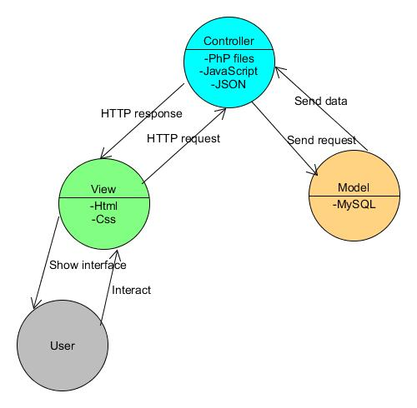
MVC

Slide 4
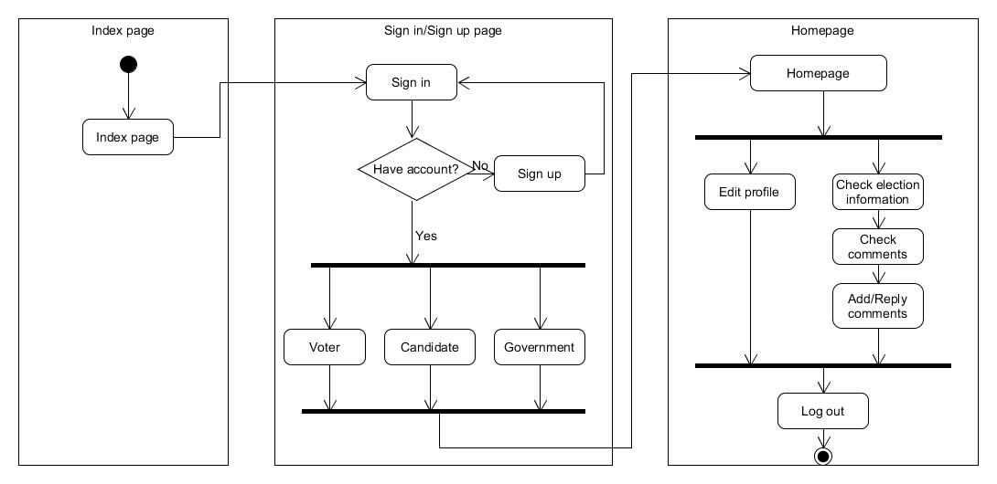
Domain Driven Design, UMLing, & MVP-1

Slide 5
Lo-fidelity prototype
Display and discuss your team’s lo-fidelity prototype
  Describe key activities and interaction flow

Slide 6
Requirements, Kanban & GitHub review
Illustrate, quickly go over, your team’s evolved requirements document
Any other changes in your project from your team’s last presentation?
-We have added more features to our website that should indicate how biased the admin is.
Illustrate your updated Kanban (in GitHub)
    https://github.com/Nick-liu666/374group-project/projects/3
    envisioned barriers:
    - Increasing transparency and indicating bias.
    - Limitation of the governmental actions on the website.

Slide 7
Review your team’s GitHub
  Describe the files structure and file “up-to-dateness”
  Provide team’s “stamp of approval” that it is up to date

Slide 8
Group reflection
How did you feel about this milestone? What did you like about it? What did you dislike?
  [Response here]
What did you learn about yourself as you collaborated and worked through this milestone?
  [Response here]
How will you use what you have learned going forward?
  [Response here]
What “stuff & things” related to this milestone would you want help with?
  [Response here]

